Slide 1








Together We Are Better LLM, IDE and Semantic Embedding to Assist Move Method Refactoring
Abhiram Bellur University of Colorado Boulder Fraol Batole Tulane University
Malinda Dilhara Amazon Web Services Mohammed Raihan Ullah University of Colorado Boulder
Yaroslav Zharov JetBrains Research Timofey Bryksin JetBrains Research
Kai Ishikawa NEC Corporation Haifeng Chen NEC Laboratories America
Masaharu Morimoto NEC Corporation Shota Motoura NEC Corporation
Takeo Hosomi NEC Corporation Tien N. Nguyen University of Texas at Dallas
Hridesh Rajan Tulane University Nikolaos Tsantalis Concordia University
Danny Dig University of Colorado Boulder, JetBrains Research
Notes:
We presented this research last September in New Zealand at the International Conference on Software Maintenance and Evolution. Don’t worry if you were not able to attend the conference, I will present it here for you.
It's been said that Teamwork makes the dream work: we have a very diverse team from several universities and several partners from the industry, I am so grateful for how they all contributed ideas that shaped the direction of this project.
If you get excited about some of these ideas and you want to collaborate with my group, I’d welcome a conversation.

Slide 2

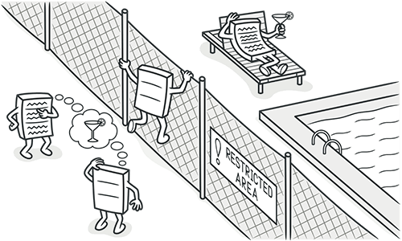
Why MoveMethod Matters
Top-5 most common refactoring
Improves cohesion, reduces coupling
Reduces Technical Debt and removes code smells: God Class, Feature Envy, Duplicate Code
GOD
Notes:
Move Method refactoring is among the top-5 refactorings in practice. This refactoring takes a misplaced method that interacts more with another class state than its own class and moves it to the correct class.
It improves cohesion, reduces coupling, and removes smells like <CLICK> God Class or >CLICK> Feature Envy.
=========
Misplaced methods, that is methods that interact more with another class state than its own, are a major contributor to Technical Debt and code smells.
CLICK> They are responsible for very large, bloated classes, sometimes called God Classes, that have too many responsibilities.
CLICK> They also result in Feature Envy, where a method craves access to the state variables of another class, instead of operating with state variables and fields from its own class.

Slide 3
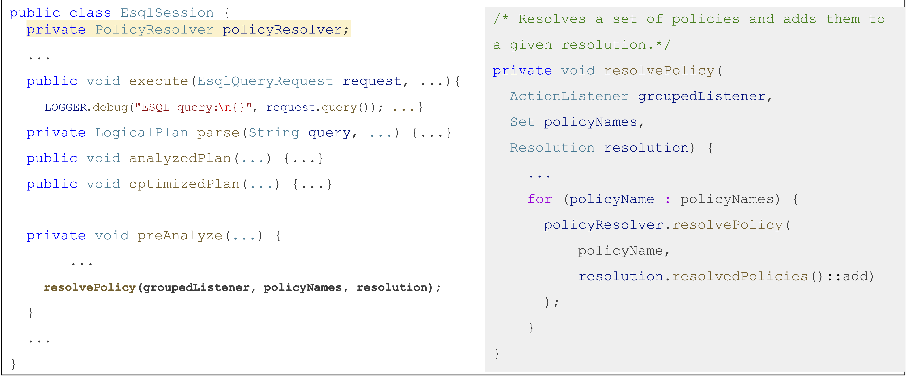
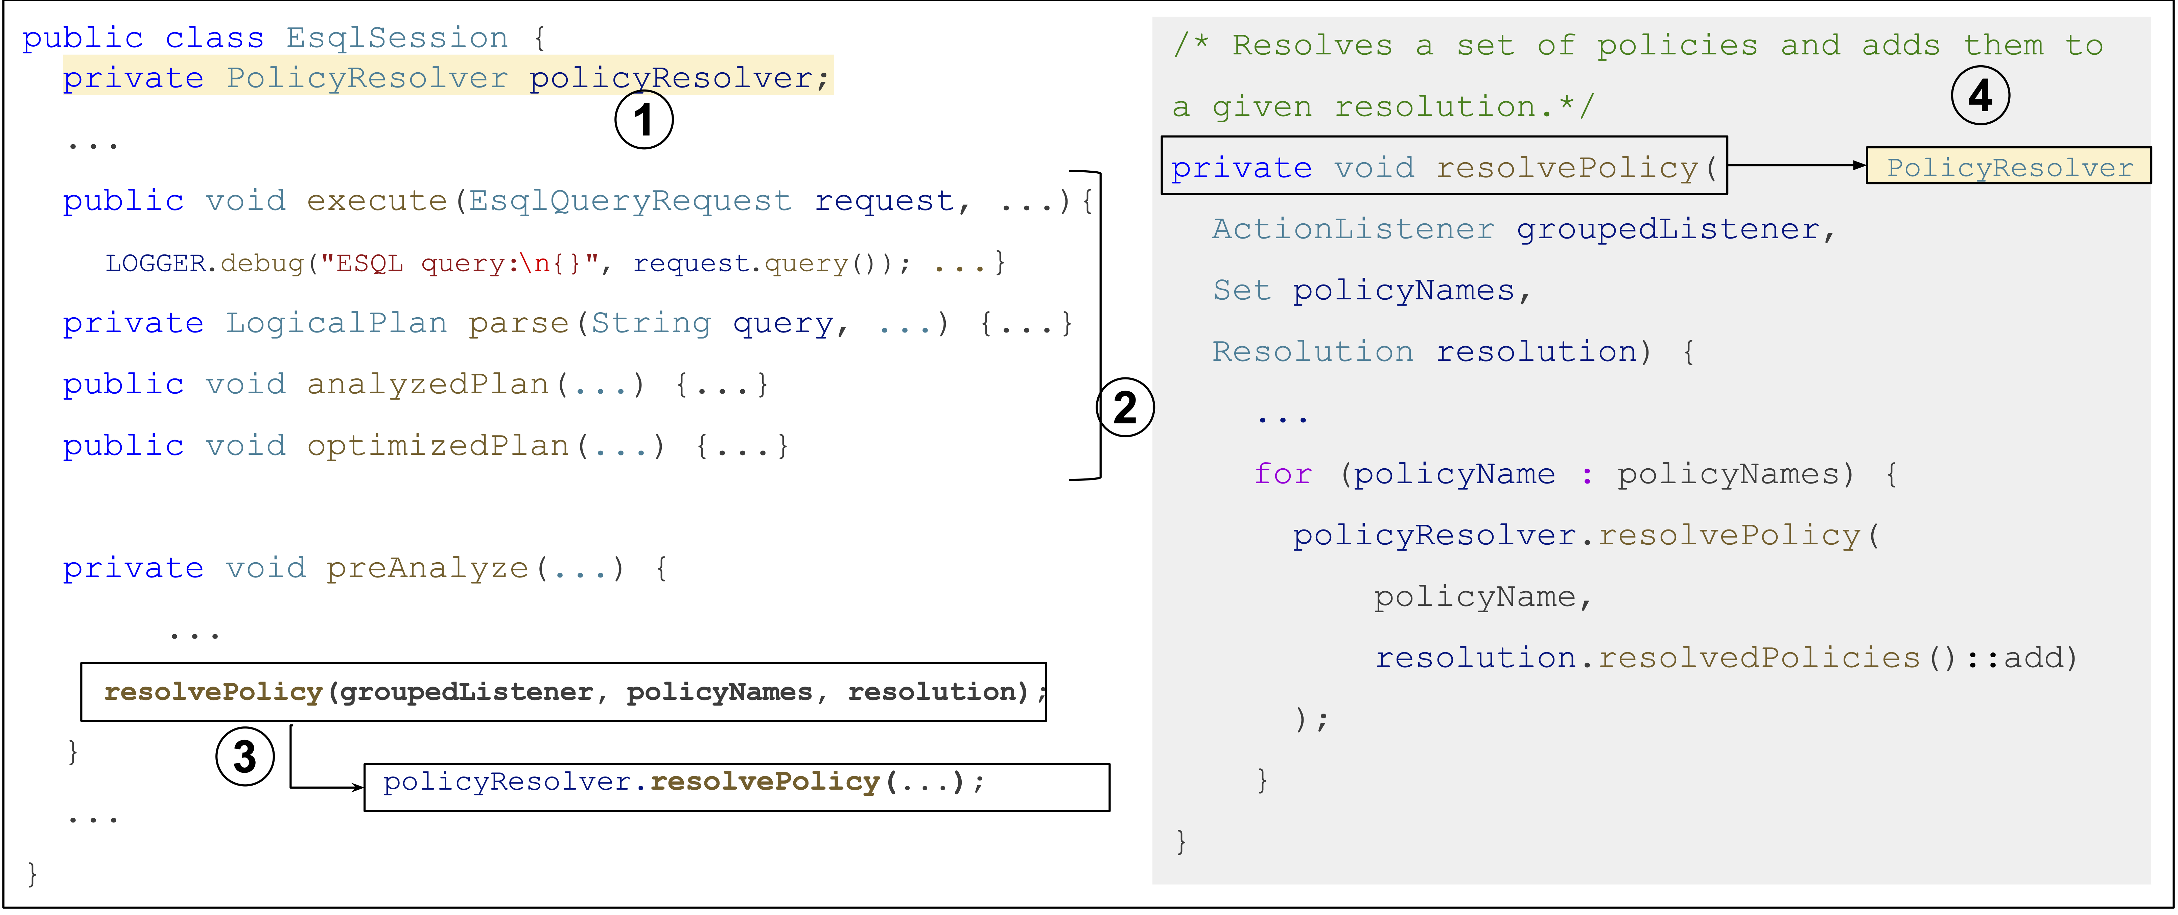

MoveMethod Refactoring to the Rescue
ElasticSearch (876e7015)
PolicyResolver
this.resolvePolicy
Notes:
Let's look at a real-world refactoring from the ElasticSearch project. In class EsqlSession, the developers identified the resolvePolicy method (seen on the right) to be out of place as it interacts heavily with PolicyResolver and moved it there.
CLICK>
Developers moved this method and updated its body to adjust the right accesses.
CLICK >
And they updated the call sites to the method.
Automating these changes saves developers significant effort during software maintainance.

Slide 4
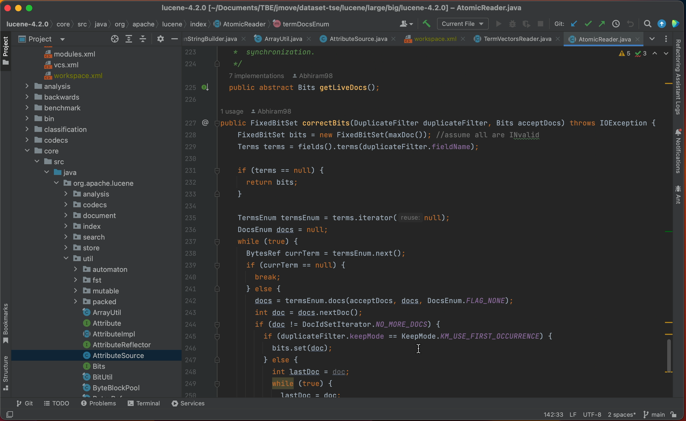


Current Move Method Workflow in IntelliJ
JetBrains’ IntelliJ IDEA has Move Method capabilities
Semi-automated process
No automatic recommendations
Notes:
Modern IDEs, such as JetBrains’ IntelliJ IDEA, automate several parts of the Move Method refactoring lifecycle. However, this is a semi-automated process, in which the developer has to manually determine which method is out of place, and which target class is a better suitable home for such misplaced method.

Slide 5

Approaches for MM Recommendations
Static analysis (JMove, JDeodorant)
- thresholds, slow (hours), poor scalability
ML (RMove, PathMove) / DL (FeTruth, Hmove)
- need retraining, overwhelm users
?
Optimize software quality metrics
Do not align with how developers refactor code
LLMs
- prolific, capture semantic intuition
Notes:
The research community has been quite active in the movemethod recommendation.
Static analysis tools (e.g., JMOVE): rely on thresholds, don’t scale, take hours.
ML/DL tools (e.g., FETRUTH, HMOVE): require retraining, treat it as classification, overwhelm devs with dozens of noisy recommendations.
CLICK: because these approaches all work based on optimizing software quality metrics, they tend to generate recommendations that do not align with how developers refactor code.
LLMs bring new hope — as they capture semantic misfits and better align with developer intuition. We hypothesize that, due to their extensive pre-training on billions of methods and their reliance on the naturalness of code.
===
We, LLMs can generate an abundance of MOVEMETHOD recommendations. We also expect LLM recommendations to better align with expert practices

Slide 6
MoveMethod Refactoring Case Study
ElasticSearch (876e7015)
PolicyResolver
LLM – target class hallucination
Hmove top-2
LLM - hallucination
Jmove :/
this.resolvePolicy
Notes:
Let’s revisit our motivating example using various tools to perform the moveMethod.
CLICK> First we asked HMove (the previous SOTA) for MM recommendations, and it suggested these two methods, but unfortunately they were not the ones moved by the developers.
CLICK> Next, we asked JMove (a static analysis tool), and it produced no suggestions for this class.
Both Hmove and Jmove analyze the whole project to compute dependencies, thus they ran for several hours, which indicates another drawback of prior works.
Next, we asked the LLM for MM recommendations. It suggested several methods to move.
Amazingly, it also suggested moving resolvePolicy method to PolicyResolver class (exactly what the developers did)
However, LLM also hallucinated while picking the target class – it recommended move to classes which do not exist.
This motivates our work.

Slide 7
Key Challenges in using LLMs
LLM Hallucinations - 80% invalid recommendations
Context window limits – can’t reason over large projects
Workflow fit –practical needs to be fast, IDE-integrated, don’t overwhelm developers
Notes:
However, there are several challenges we need to solve before we can use LLMs effectively.
Hallucinations — invalid or impossible recs dominate. Up to 80% of recommendations are invalid.
Context window — MOVEMETHOD refactoring requires global, project-level reasoning to determine the best target classes where to relocate a misplaced method. However, passing an entire project in the prompt is beyond the limited context window of current LLMs. So we can’t feed entire project, even if we could, this would not help as LLMs lose focus.
Workflow fit — practical needs: tools must be fast, lightweight, and IDE-integrated, and must not overwhelm developers with too many false positives.

Slide 8

Our Insights
Combine LLM creativity + IDE rigor
Filter hallucination via static preconditions checks in IDE
Semantic embeddings + Refactoring-aware RAG
Few high-quality recommendations (≤3 per class)
Our tool: MM-Assist, an IntelliJ Plugin
Notes:
Combine LLM creativity with IDE rigor: science + art.
We discovered novel ways to automatically eliminate LLM hallucinations, by complementing LLM reasoning (i.e., the creative, non-deterministic) with static analysis embedded in the IDE (i.e., the rigorous, deterministic, scientific part).
Use semantic embeddings + refactoring-aware RAG to narrow context of the search space.
For a practical user experience, we present devs with just a few high-quality, actionable suggestions (≤3/class) that are guaranteed to execute correctly with the IDE.
We implemented these ideas MM-ASSIST is an IntelliJ plugin that automates the entire Move Method lifecycle.

Slide 9
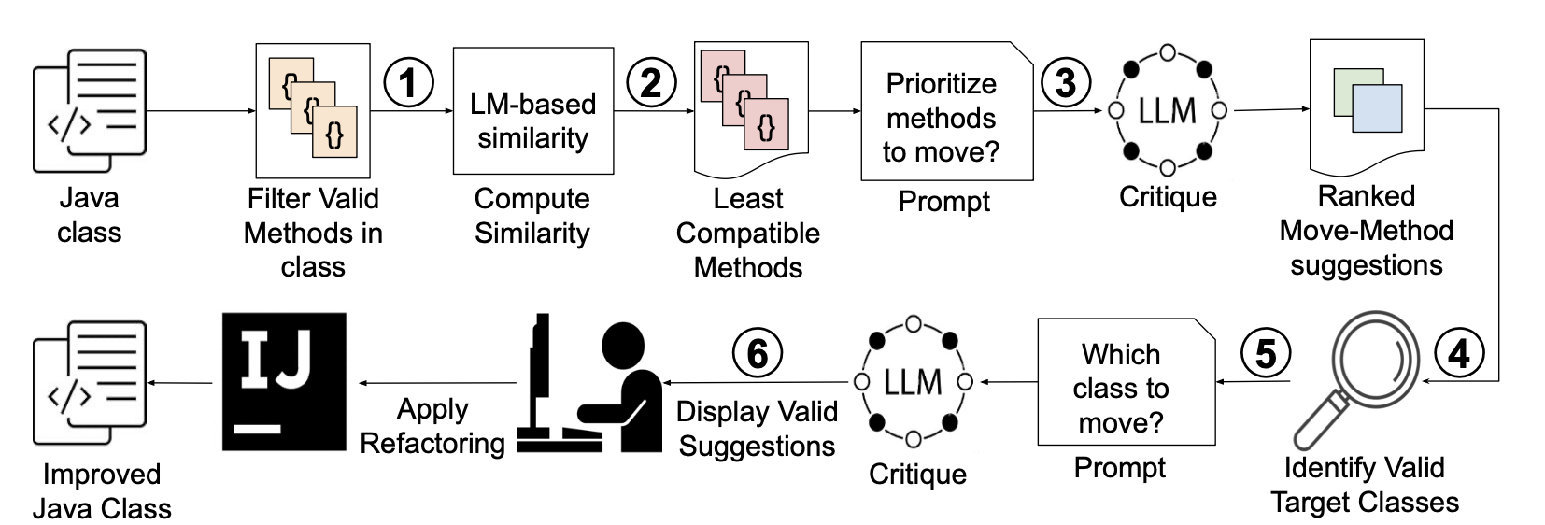
MM-Assist: Workflow
Notes:
Pipeline: preconditions → embeddings → LLM critique & ranking → semantic RAG → IDE executes safely.
Key: synergistically combines LLM, IDE, embeddings, and static analysis.
Developers stay in control, approving only what they trust.

Slide 10
Empirical Evaluation Setup
Two Datasets:
Synthetic corpus of 235 MM scenarios
New real-world corpus 210 MM (2024+, OSS), avoids LLM training contamination
Formative study, OSS replication, repository mining, user study, questionnaire survey
Baselines: JMove, FeTruth, HMove, Vanilla LLM
User study: 30 participants, 1 week, own project
Notes:
Two datasets:
Synthetic corpus (widely used in prior work).
New real-world corpus: 210 actual refactorings mined from 2024+ OSS commits — avoids LLM training contamination.
we designed a comprehensive, multi-methodology evaluation using both quantitative and qualitative methods
Compared against previous SOTA: JMOVE, FETRUTH, HMOVE, and vanilla LLMs.
Plus: user study — 30 developers used MM-ASSIST on their own projects for a week.
======
RQ1: How effective are LLMs at suggesting opportunities for MM refactoring?
RQ2: How effective is MM-ASSIST at suggesting opportunities for MM refactoring?
RQ3: What is MM-ASSIST’s runtime performance?
RQ4: How useful is our approach for developers

Slide 11
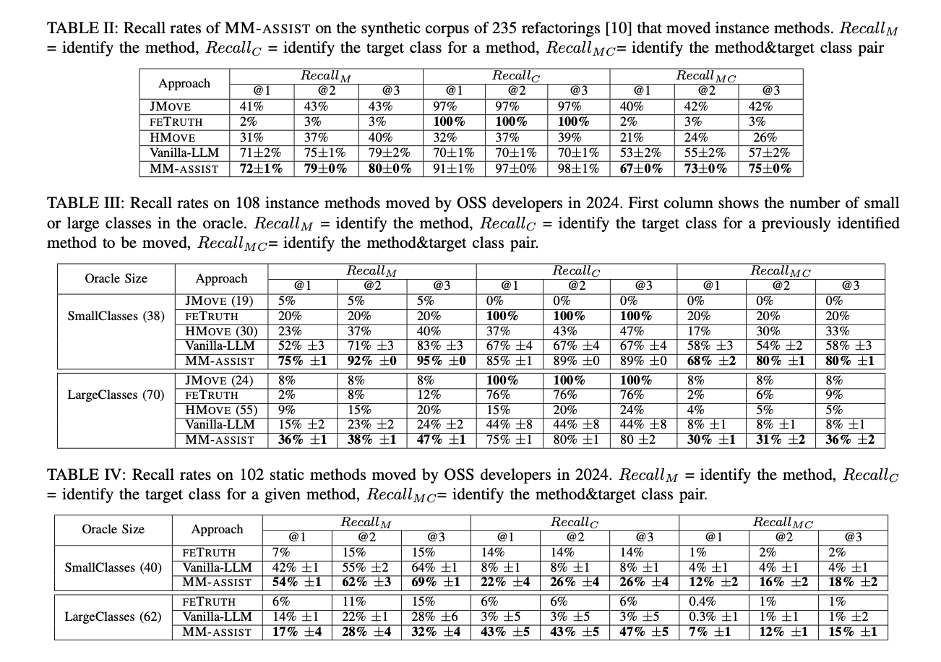
Results: Synthetic Corpus
Metric: Recall@K for top-K recommendations
Synthetic corpus: 235 MM scenarios
MM-ASSIST Recall@1 = 67%, Recall@3 = 75%
1.7x improvement over best baseline
LLM alone performed better than old tools but still plagued by hallucinations
Notes:
MM-ASSIST Recall@1 = 67%, Recall@3 = 75%.
Baselines: JMOVE ~40%, HMOVE ~26%, FETRUTH only 2–3%.
1.7x improvement over best baseline.
LLM alone performed better than old tools but still plagued by hallucinations

Slide 12

Results: Real-World Corpus + User study
Replicated 210 OSS refactorings (uncontaminated by LLM training)
MM-ASSIST Recall@3 = 80% vs 33% (best baselines) → 2.4x improvement.
Runtime: ~30 seconds vs hours or days for baselines.
User study: 30 devs, used on own project for a week
1150 analyzed classes -> gave recommendations in 350 classes
83% positive ratings
avg. 7 accepted refactorings/user.
Notes:
On 210 OSS refactorings: MM-ASSIST Recall@3 = 80% vs 33% (HMOVE). → 2.4x improvement.
Runtime: ~30 seconds vs hours/days for baselines.
User study: 30 devs, 350 classes analyzed → 82.8% positive ratings, avg. 7 accepted refactorings/user.
Dev quote: “Skeptical about AI, but glad to delegate grunt work.”
===============
30 students (25 Master’s and 5 Ph.D. students)
73% have industrial experience.
30 participants applied MM-ASSIST on 350 classes. MM-ASSIST analyzed 1,143 classes
Positive Rating 82.8% of the time
applied a total of 216 refactoring recommendations on their code

Slide 13
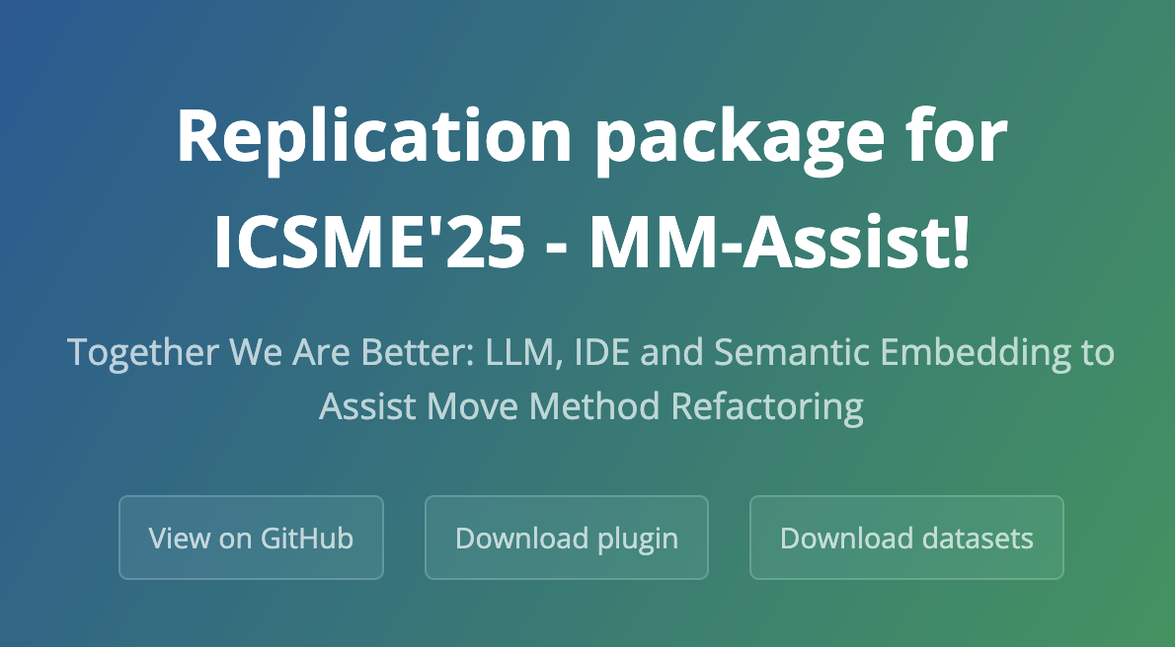
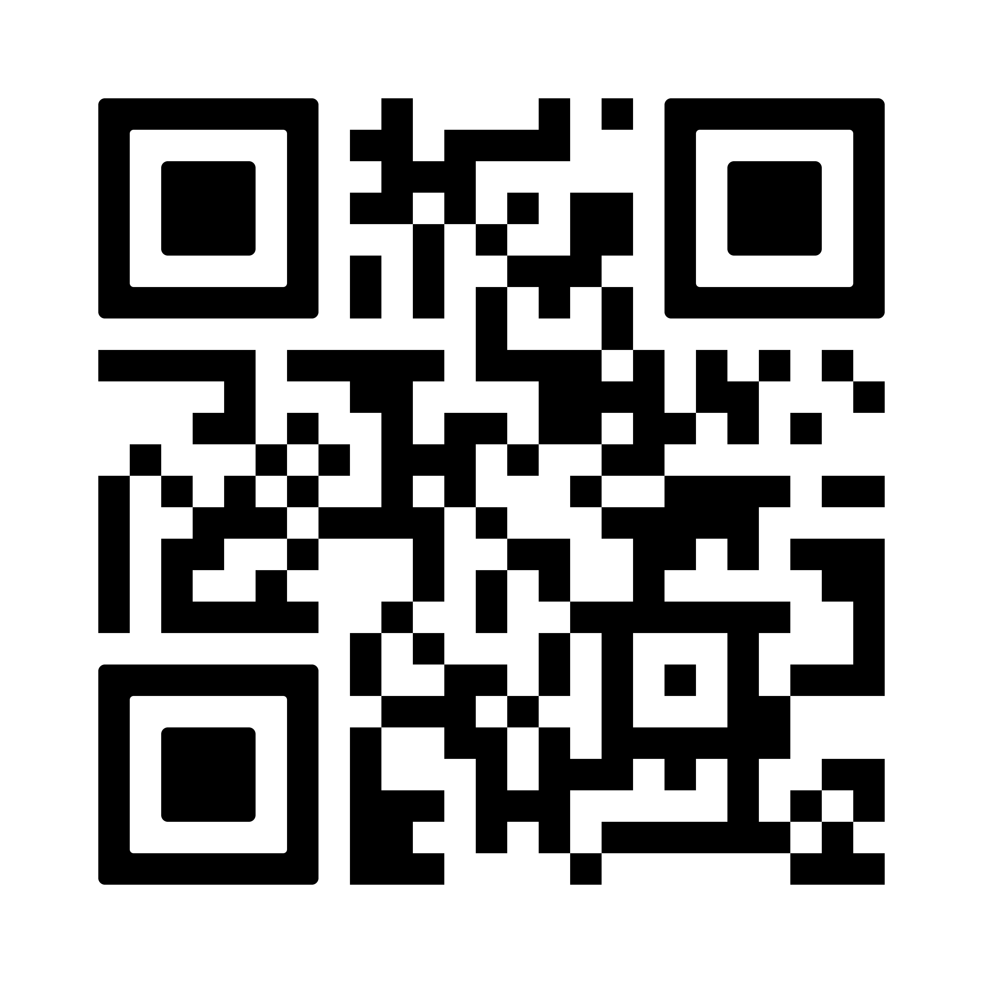
MM-Assist Summary
First end-to-end LLM-powered Move Method assistant
LLM + IDE + Human >> Sum of the individual parts
LLMs (creative)+ IDE (validation) + Refactoring-Aware RAG (lookup)
2–4× better recall, 10–100× faster, 5 cents / class
Trusted by developers (83% positive)
Ongoing work: refactoring agents
Notes:
MM-ASSIST: first end-to-end LLM-powered Move Method assistant.
Tackles hallucinations + context limits via IDE validation + semantic RAG.
Outperforms SOTA: 2–4x better recall, 10–100x faster. It saves developer a lot of time, all of these for the low-level cost of 5cents/per class
Developers trust and adopt it.
Broader impact: techniques generalize to other refactorings (Extract Class, Split Package).
Together, LLMs + IDE + semantic analysis are stronger than any alone.

Slide 14
MoveMethod-Assist DEMO

Slide 15
ExtractMethod-Assist DEMO

Slide 16
Your questions
1. Robustness, Reliability, and Failure Modes (Very Popular)
Core theme: When and why does MM-Assist fail, behave inconsistently, or give brittle results?
2. Subjectivity, Human Judgment, and Architectural Intent (Very Popular)
Core theme: The tension between automated refactoring and human design intent.
3. Generalization Across Codebases, Domains, and Technical Debt (Very Popular)
Core theme: How well does the approach transfer beyond “clean” or familiar projects?
4. Dependence on Language, Tooling, and Ecosystem (Popular)
Core theme: How much of the success is Java- and IntelliJ-specific?
5. Semantics, Embeddings, and Representation Quality (Popular)
Core theme: Are embeddings the “right” abstraction for code organization?
Notes:
1. Robustness, Reliability, and Failure Modes (Very Popular)
Core theme: When and why does MM-Assist fail, behave inconsistently, or give brittle results?
2. Subjectivity, Human Judgment, and Architectural Intent (Very Popular)
Core theme: The tension between automated refactoring and human design intent.
3. Generalization Across Codebases, Domains, and Technical Debt (Very Popular)
Core theme: How well does the approach transfer beyond “clean” or familiar projects?
4. Dependence on Language, Tooling, and Ecosystem (Popular)
Core theme: How much of the success is Java- and IntelliJ-specific?
5. Semantics, Embeddings, and Representation Quality (Popular)
Core theme: Are embeddings the “right” abstraction for code organization?

Slide 17
Your Discussion Points
1. Role of LLM vs. System Orchestration (Very Popular)
Core idea: Understanding what actually drives MM-Assist’s success—LLM reasoning or careful system design.
2. Narrow Focus vs. General Insights (Very Popular)
Core idea: Examining whether focusing on Move Method refactoring constrains or sharpens insights.
3. Safety, Correctness, and Refactoring Hygiene (Popular)
Core idea: Concerns around correctness, anti-patterns, and reversibility of refactorings.
4. Metrics, Evaluation, and Recommendation Strategy (Popular)
Core idea: Evaluating the task as a recommendation problem and how we measure success.
Notes:
1. Role of LLM vs. System Orchestration (Very Popular)
Core idea: Understanding what actually drives MM-Assist’s success—LLM reasoning or careful system design.
2. Narrow Focus vs. General Insights (Very Popular)
Core idea: Examining whether focusing on Move Method refactoring constrains or sharpens insights.
3. Safety, Correctness, and Refactoring Hygiene (Popular)
Core idea: Concerns around correctness, anti-patterns, and reversibility of refactorings.
4. Metrics, Evaluation, and Recommendation Strategy (Popular)
Core idea: Evaluating the task as a recommendation problem and how we measure success.

Slide 18

Lessons Learned
LLMs are Prolific but with High rate of hallucinations:
- ExtractMethod: 73% rate of hallucinations
- MoveMethod 80% hallucinations
- PyCraft: 65% hallucinations
- Unit tests: 35% hallucinations
Do what LLM suggests, not what they do => need for powerful validators
remove hallucinations automatically reusing static analysis from the IDE (e.g., refactoring precondition) Where else can we reuse the IDE as validator?
new static analysis
dynamic analysis: generated small unit tests in PyCraft, used original code variant as validator
22
Notes:
I want to share the Biggest ahas and lessons that we learned, some the hard way. Sharing these with you so you can go further then we did:
CLICK> LLMs are very creative and prolific when asked for suggestion, albeit with a high-rate of hallucinations
CLICK> One of the biggest breakthroughs came when we followed the same approach we do with the family doctors: do what they tell you to do (eat healthy, exercise more, get good rest), but don’t do what they do.
We made a huge leap forward when we stopped asking the LLM to make the code transformations, and only asked for suggestions. We used the IDE and our program analysis and transformation by example rules to validate suggestions and execute them correctly.
I want to ask in your work, where else can you employ the full power of the IDE to complement the weaknesses of the LLMs?
we designed new static analysis to validate LLM suggestions
in PyCraft we generated unit tests and we executed them against the generated code variants to validate they are equivalent to the original code idiom,

Slide 19
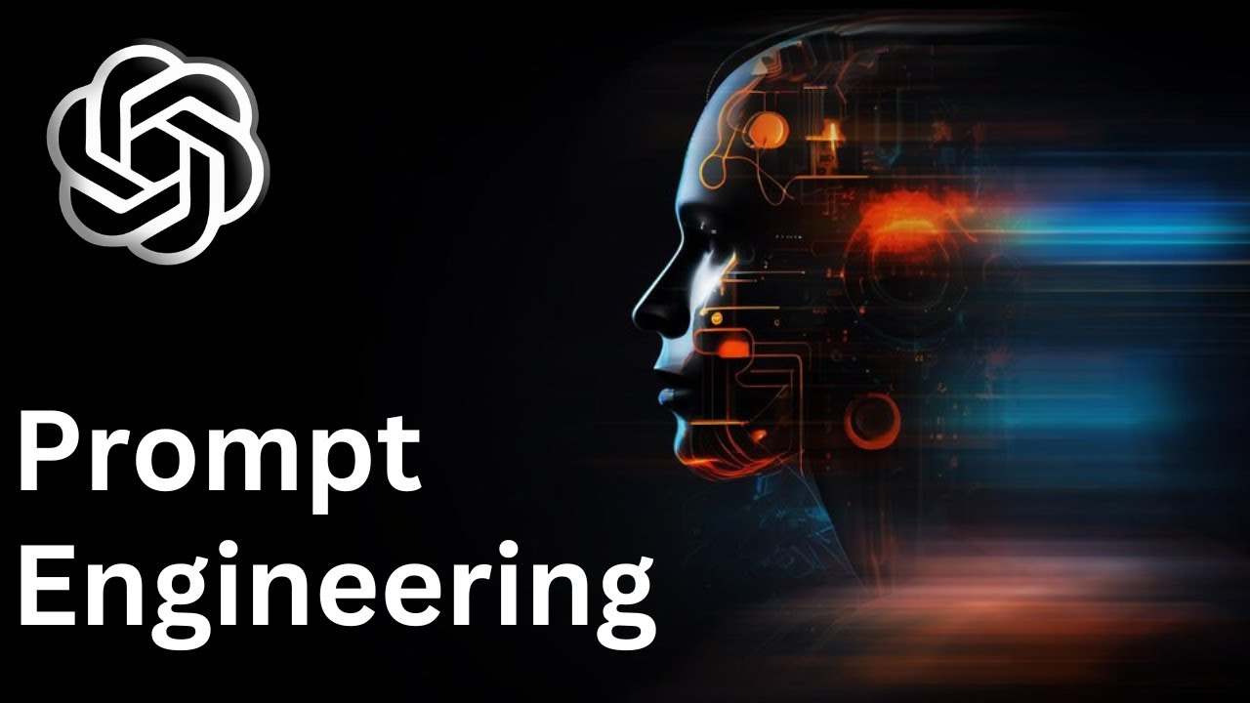
Lessons Learned
Precise prompt for higher quality suggestions
append line numbers for the code input
ask LLM to give you precise response using line numbers
ask LLM to specify the output in structured format (JSON): useful if the output is consumed by other tools
Few-shot learning worked best for both EM-Assist and PyCraft
For MoveMethod-Assist: RAG needed to focus the LLM laser in large projects, along with Chain-of-Thought
23
Notes:
Prompt Engineering: The more precise we were with the prompt, the higher quality of the suggestions from the LLM.
in our prompt we added line numbers to the input source code and asked the LLM to give us precise response using line numbers
another big breakthrough came when our colleague Egor suggested us to force the LLM to communicate the result using a structured format
Few-shot learning worked best for both tools. WE give a couple of examples in the prompt.

Slide 20

Lessons Learned: Taming LLM nondeterminism
To get consistent high-quality suggestions, you need to reprompt (in the background), accumulate results shown to the user
Re-prompting not a waste
Newly-designed ranking to match LLM workflow (e.g., popularity of suggestions, heat map of the code affected by suggestions)
Sweet spot: tuning LLM hyperparameters (e.g., temperatures and number of iterations) is essential
Higher randomness in Large Language Models is preferred when a solid validation framework exists
24
Notes:
CLICK> We discovered a new set of best practices when using LLMs compared with previous static analysis approaches.
One of the biggest challenges with LLMs is taming non-determinism. Unlike in traditional static analysis where we avoid computing the same thing twice,
re-prompting (asking the same question several times) and creating a superset of all suggestions was Key to get the most out of the LLM. As a consequence, we designed unique ranking methods to take into account this LLM workflow.
CLICK> Temperature: while in general higher temperatures and number of iterations produce better results, there is a sweet spot for the temperatures/iterations, after that the number of hallucinations increases dramatically

Slide 21
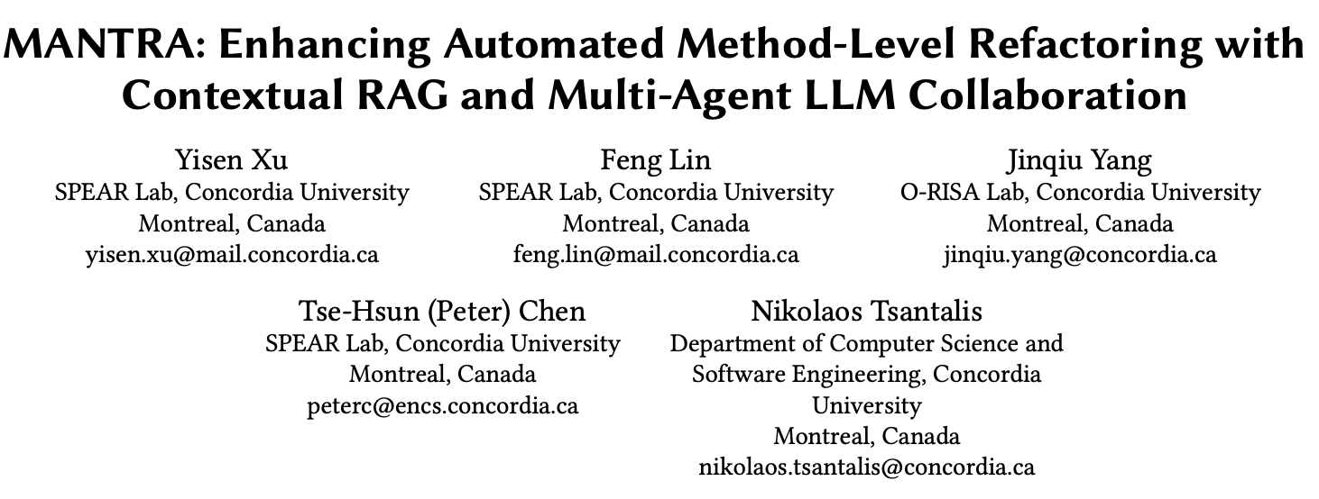
MANTRA DEMO

Slide 22
Your questions
Why does the reviewer agent contribute the most to the system’s performance?
How to use Mantra?
Why were these six refactorings chosen over other common refactorings?
Would MANTRA still work if refactorings were embedded in ongoing development rather than
isolated “pure” commits?
Are compilation and test success sufficient proxies for refactoring correctness in all cases?
How often does the repair phase introduce changes that go beyond structural refactoring?
How dependent is MANTRA on high-quality test coverage?
Notes:
Why does the reviewer agent contribute the most to the system’s performance?
How to use Mantra?
Why were these six refactorings chosen over other commonrefactorings?
Would MANTRA still work if refactorings were embedded in ongoing development rather than isolated “pure” commits?
Are compilation and test success sufficient proxies for refactoring correctness in all cases?
How often does the repair phase introduce changes that go beyond structural refactoring?
How dependent is MANTRA on high-quality test coverage?

Slide 23
Your discussion points
1> Trust, Hallucinations, and What “Correctness” Means Whether MANTRA’s safeguards are actually sufficient, and what we should accept as “correct” in LLM-assisted refactoring.
2> Why the Reviewer Agent Matters So Much The ablation result that the reviewer agent is central to MANTRA’s success.
3> Cognitive Load, Developer Experience, and Human Trust Whether agentic tools truly help developers—or just shift effort elsewhere.
Notes:
Trust, Hallucinations, and What “Correctness” Means
What students want to discuss: Whether MANTRA’s safeguards are actually sufficient, and what we should accept as “correct” in LLM-assisted refactoring.
Why the Reviewer Agent Matters So Much
What students want to understand: The ablation result that the reviewer agent is central to MANTRA’s success.
Cognitive Load, Developer Experience, and Human Trust
What students want to debate: Whether agentic tools truly help developers—or just shift effort elsewhere.

Slide 24
Project Ideas
1> What new project ideas did you get from reading these 4 refactoring papers this week?
Potential new directions:
Extend CoRenameAgent to support new refactoring kinds (e.g., MoveMethod – close to 90% of move methods are performed in a coordinated style, other common program changes)
Extend MoveMethod Assist to support new refactoring kinds (e.g., Split Class)
Extend MANTRA to support new refactoring kinds
Extend any of these tools to support other languages (e.g., Python), IDEs (VSCode), Language/IDE independence (e.g., via LSP)
Expand RefactoringBench to include new, uncontaminated, real-world refactorings
Implement a refactoring Agent and evaluate it against the baseline implementation from RefactorBench or MANTRA
Design a new agent that introduces Design Patterns (e.g., from the OOAD class, Gang of Four)
Notes:
Talk about next class Pitch Ideas.

